Slide 1
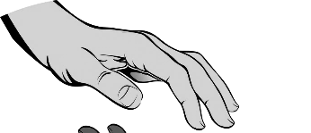
Faster waves
Water waves can be made with a plank of wood.
Bigger waves are made by pushing it down harder.

Slide 2
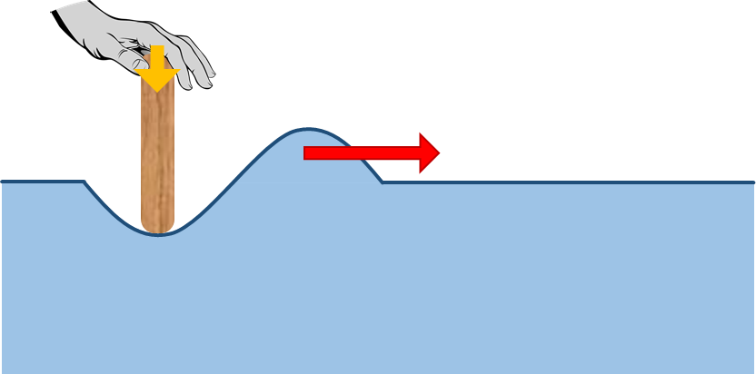
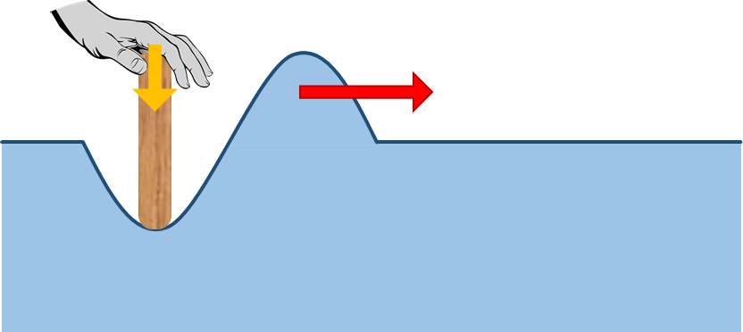
Faster waves
1a. Which wave moves faster through the water?
X
Y
A
Wave X moves faster.
B
Wave Y moves faster.
C
Both waves move at the same speed.

Slide 3
Faster waves
1b. What is the best reason for your last answer?
X
Y
A
Both waves move through the same water.
B
It has more energy.
C
It has more force.
D
Less water needs to be moved.

Slide 4
Faster waves
Waves can be made on a rope by shaking it up and down.
Shaking it quickly makes waves with a high frequency.
Shaking it more slowly makes waves with a lower frequency.
wave
Quick shake = high frequency

Slide 5
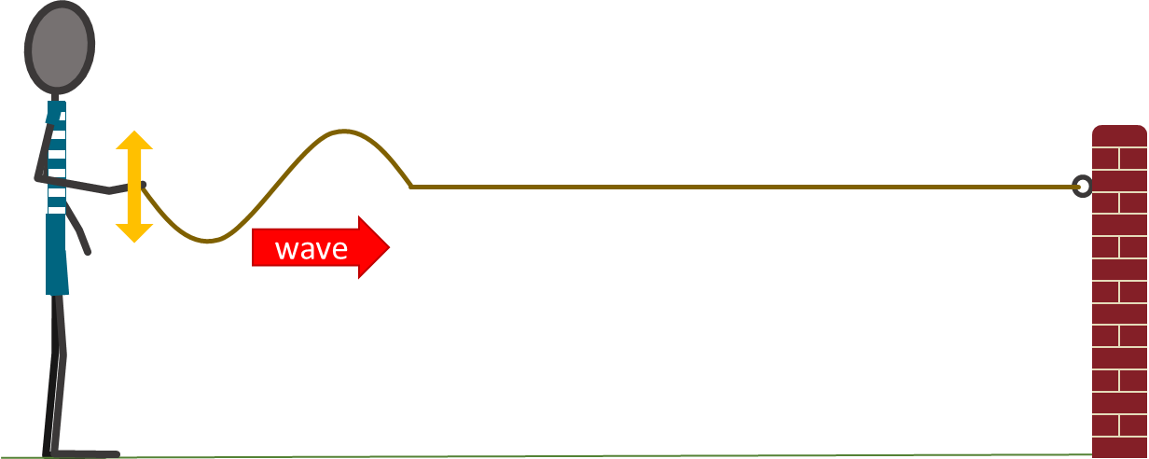
Faster waves
2a. Which wave moves faster along the rope?
X
Y
Quick shake = high frequency
Slower shake = lower frequency
A
Wave X moves faster.
B
Wave Y moves faster.
C
Both waves move at the same speed.

Slide 6
Faster waves
2b. What is the best reason for your last answer?
X
Y
Quick shake = high frequency
Slower shake = lower frequency
A
Both waves move along the same rope.
B
It has more energy.
C
It has more force.
D
Less rope needs to be moved.

